Slide 1




Slide 2

NLP Based Duplicate Bug Report Detection Using Supervised Machine Learning Algorithms
Presentation: Muhammad Umer

Slide 3
Project Member(s)
Student Name: Student ID:
Group ID:
Muhammad Umer Mansoor
BC190400681
F22024F062

Slide 4

Project Introduction
Objective:
Automatically classify bug reports as duplicate or non-duplicate.
Motivation:
Duplicate bugs waste developer time and resources.
Manual duplicate detection is tedious and error-prone.
Approach:
Leverage NLP techniques to analyze bug report text.
Extract textual features like TF-IDF vectors.
Train ML models like SVM, and Random Forest on features.
Classify new bug reports as duplicate or not.
Expected Outcomes:
Reduced triage time for developers.
Improved bug resolution efficiency.

Slide 5
Methodology
Data:
Mozilla Thunderbird project bug reports.
Preprocessing:
Tokenization, stopword removal, stemming and lemmatization, etc.
Feature Engineering:
Bag of Words, TF-IDF vectorization
Models Compared:
SVM, Random Forest, Naive Bayes
Logistic Regression, KNN, Decision Trees
Evaluation Metrics:
Accuracy, Precision, Recall, F1-Score, and Confusion Matrix.

Slide 6
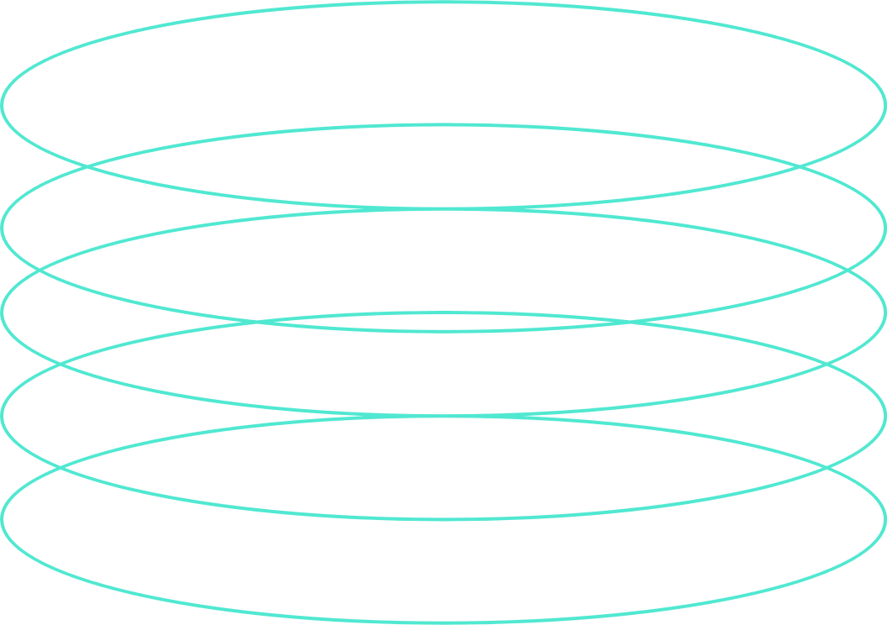
Project Scope
Load and explore the dataset of bug reports.
Preprocess textual data using NLP techniques.
Vectorize text into feature sets.
Train and tune models like SVM, and Random Forest Classifier.
Evaluate models on the separate test dataset.
Analyze results to find the best model.
Retrain models to improve accuracy.

Slide 7
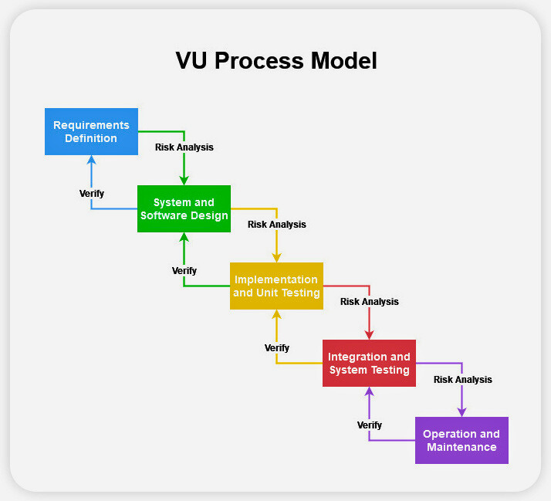
VU Process Model
The VU Process Model allows for a structured and iterative approach to the development of this NLP project, ensuring that all requirements are properly gathered and analyzed, the design is well thought out and implemented, the system is thoroughly tested and verified, and it is well maintained over time.

Slide 8

Functional Requirements
System must be set the environment online/offline (If Required).
System apply different data processing techniques (Tokenization, Stop word removal, Lemmatization, etc…).
System must Build Corpus.
System must be split the given dataset into testing and training.
System must trained the specified model.
User must be evaluate mentioned models in the form of Confusion Matrix, Accuracy, Precision, Recall etc.
User must be discussed the results of given algorithms ( Naïve Bayes, Support Vector Machine, Random Forest).
User must retrained the model if accuracy is not good (less than 60%) by changing different training parameters (If Required).

Slide 9
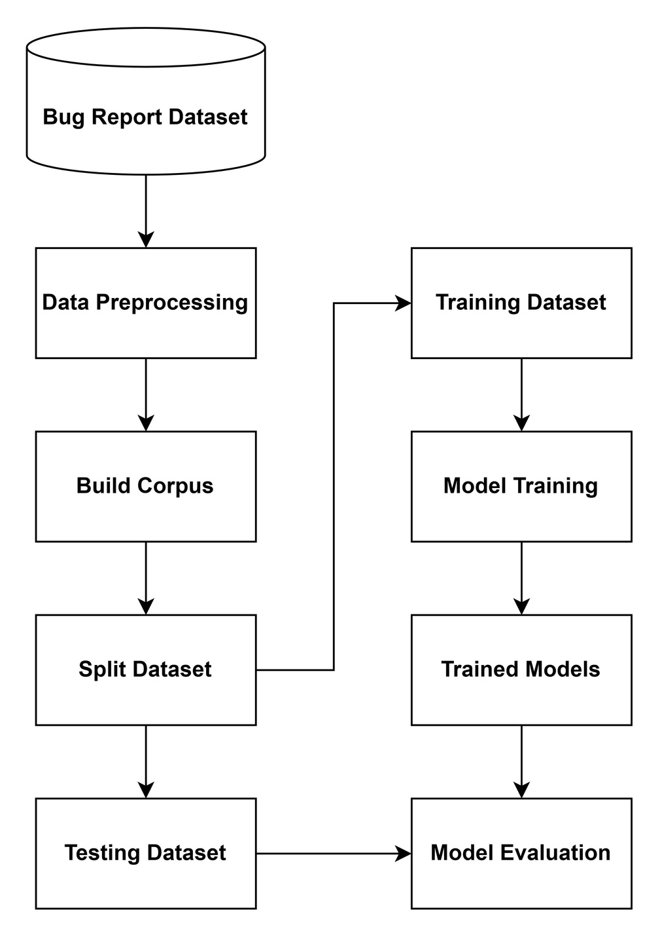
Methodology

Slide 10
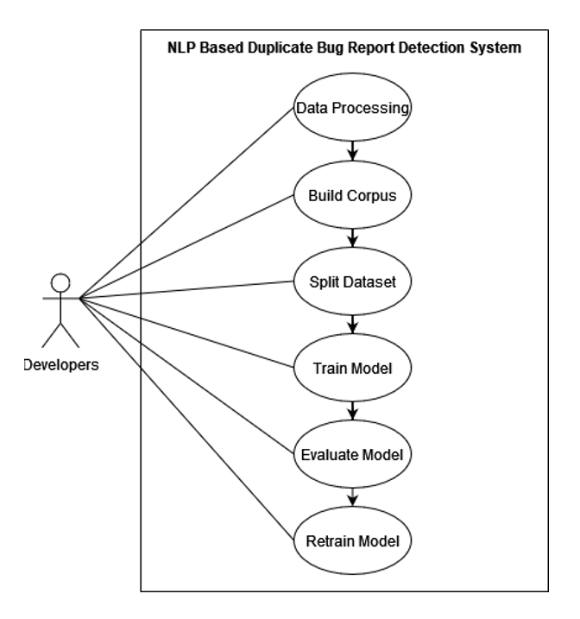
Use Case Diagram

Slide 11
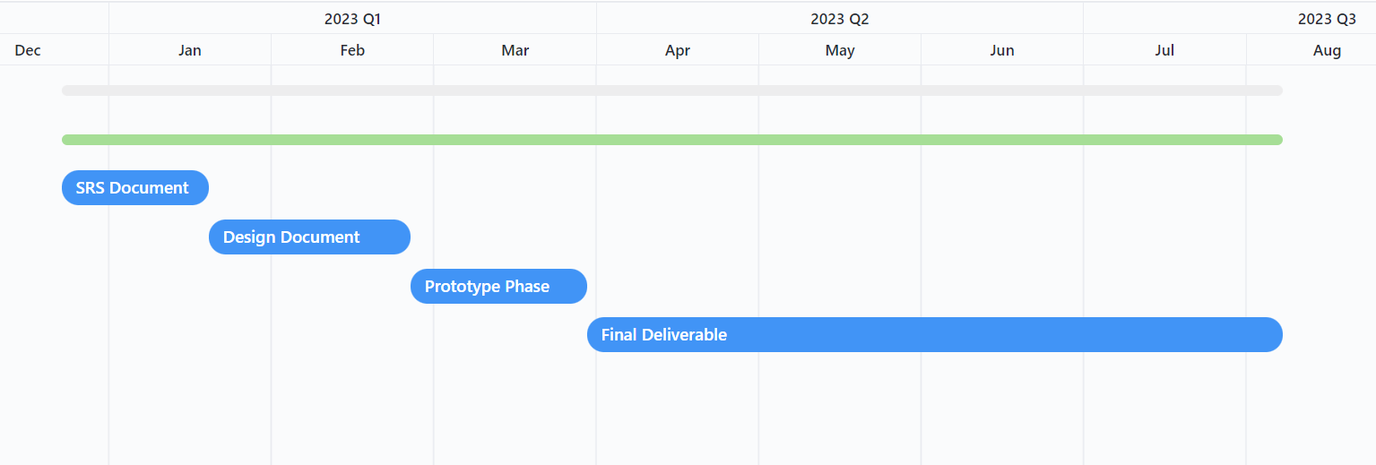
Project Schedule / Gantt Chart

Slide 12
ML Models Evaluation Results Analysis
Random Forest achieves the highest accuracy of 75% on stemmed data with BOW, compared to 60-72% for other models. It also has strong macro and weighted F1 scores of 0.75.
On lemmatized data with BOW, Random Forest has 74% accuracy, again outperforming other models in the 60-72% range. The precision, recall, and F1 scores are balanced for both classes.
With TF-IDF vectorization, Random Forest still performs very well with 73-74% accuracy on stemmed and lemmatized data, better than the other models. The precision and recall are reasonably good for both classes.

Slide 13
ML Models Evaluation Results Analysis
In contrast, models like Naive Bayes, SVM, Logistic Regression, and KNN achieve 60-72% accuracy consistently across vectorization methods, lower than Random Forest. Their F1 scores are also not as strong except for SVM and Logistic Regression.
SVM is the closest competitor to Random Forest with 68-72% accuracy. But Random Forest leverages an ensemble of trees to reduce overfitting and improve results compared to a single tree.
Naive Bayes consistently scored around 66% accuracy across all configurations. The TF-IDF vectors improved the recall for the duplicate class compared to BOW. But overall, NB was outperformed by SVM and Random Forest.

Slide 14
ML Models Evaluation Results Analysis: My Final Remarks
In terms of stemming vs lemmatization, the results are quite close for Random Forest on both versions of the dataset. The stemmed version has slightly higher accuracy in some cases. But both achieve good results overall.
Concluding this, I would say that lemmatization does not really improve results over stemming for this dataset. Both versions give comparable model performance. This suggests the context needed for lemmatization does not provide much benefit here.
Random Forest would be my choice as the best model for this dataset based on its high accuracy, good F1 score, balance between precision and recall, and robust performance across vectorization methods. I think that some hyperparameter tuning may further improve its effectiveness.

Slide 15








Tools Used
Visual Studio Code
SKLearn
Jupyter Notebook
spaCy
Conda: Miniconda
Matplotlib
Python
Seaborn

Slide 16
Thanks

